Slide 1
Calvary Chapel Sun City
Gin Remodel Project
11/12/2023

Slide 2
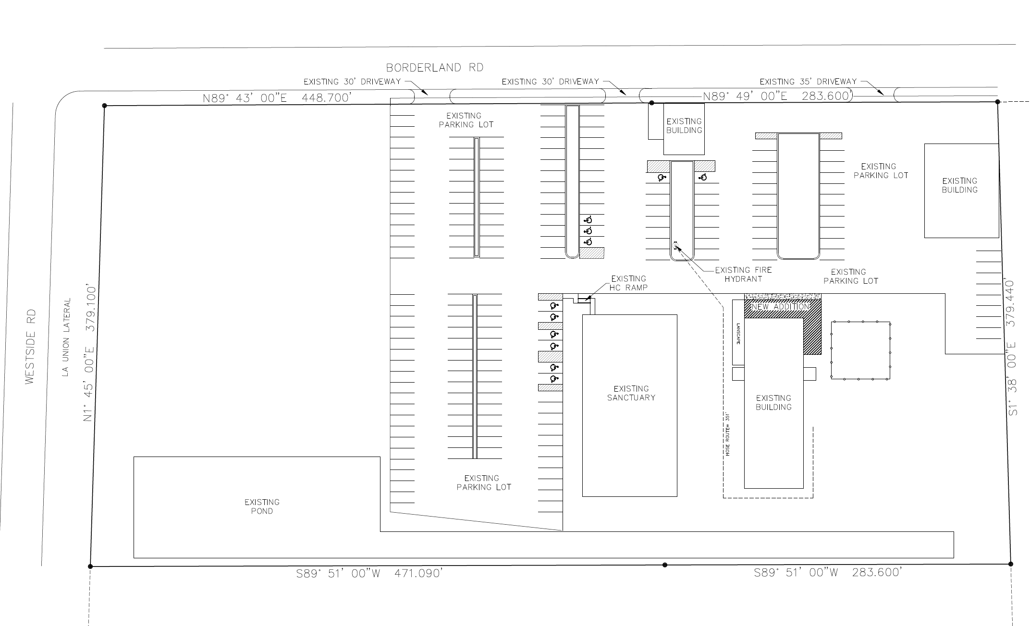

Slide 3
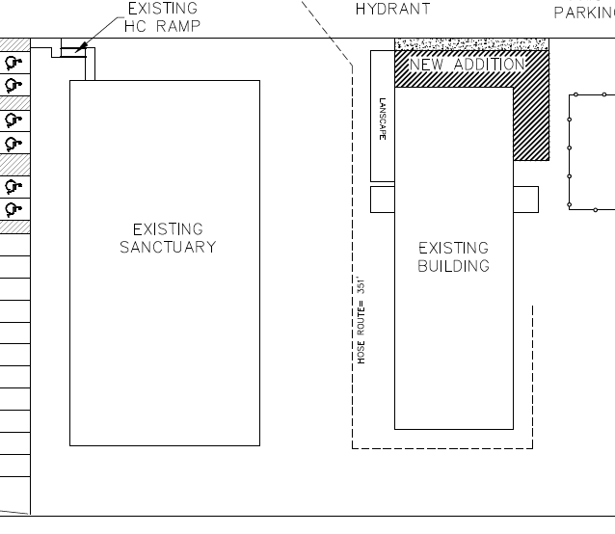

Slide 4
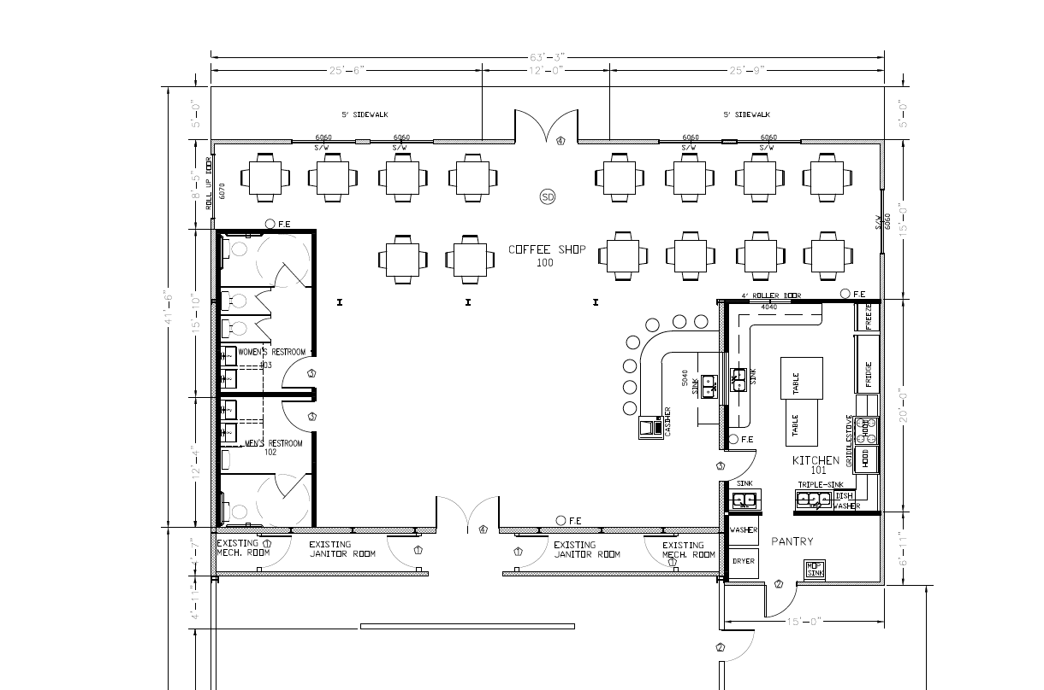

Slide 5
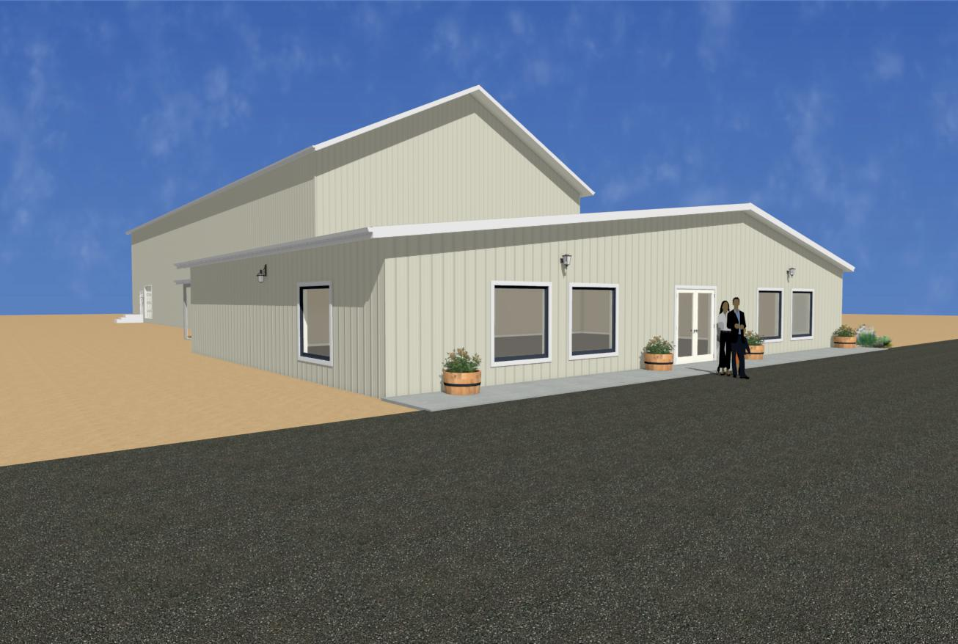

Slide 6
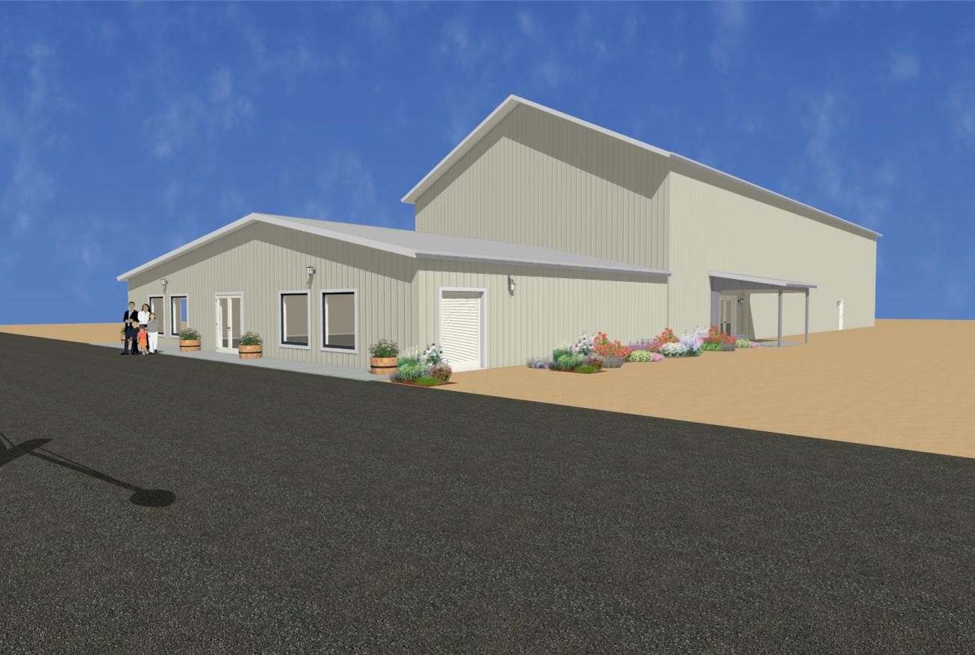

Slide 7
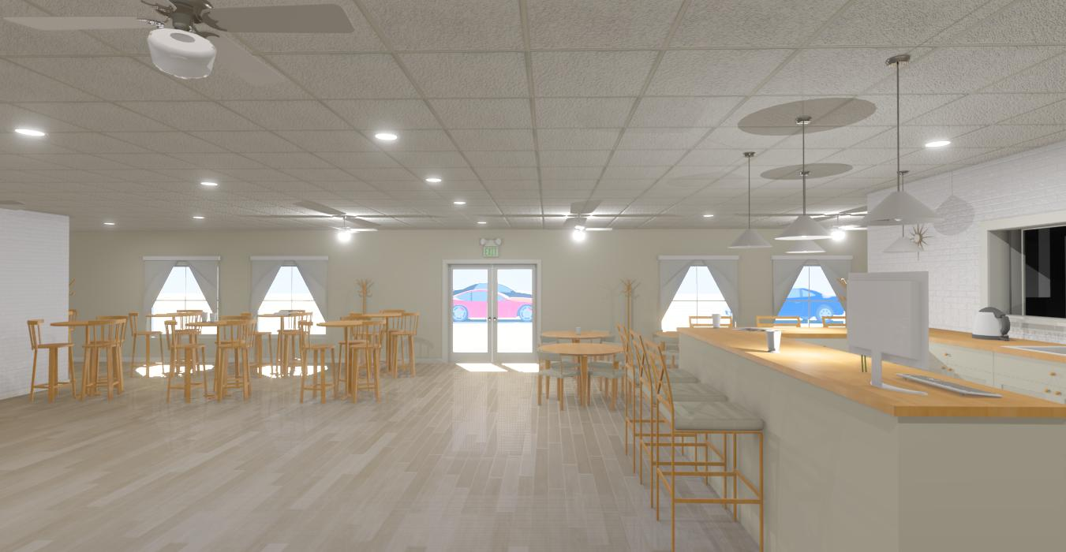

Slide 8
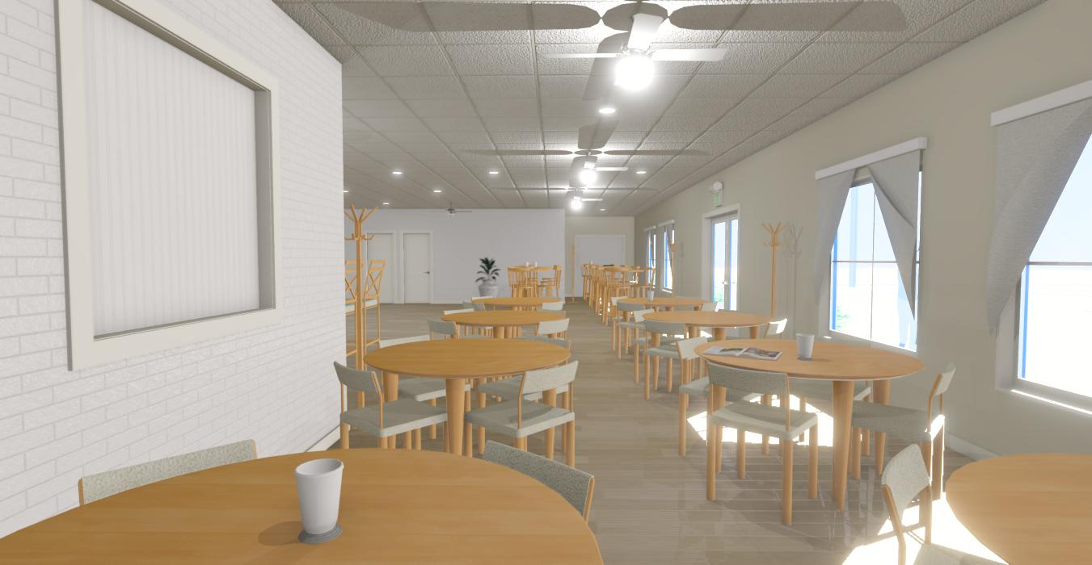

Slide 9
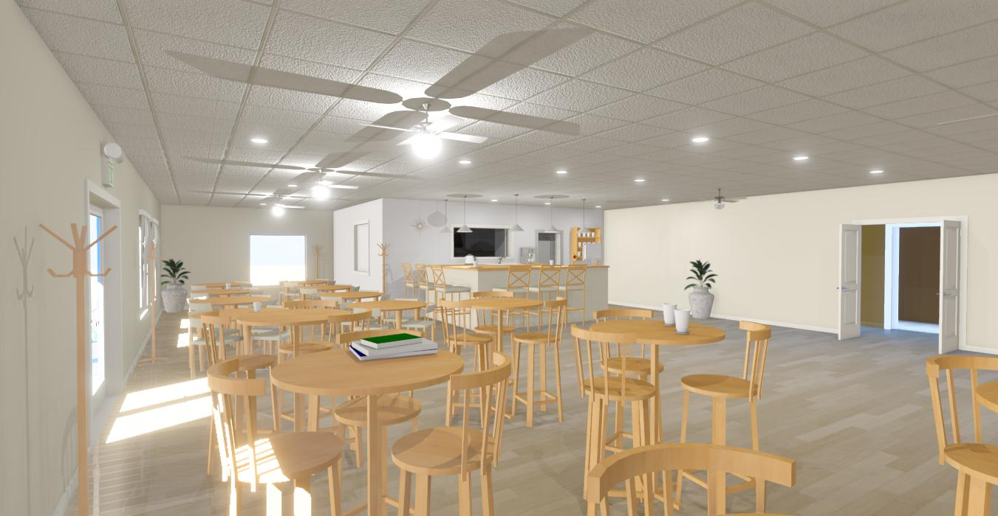

Slide 10
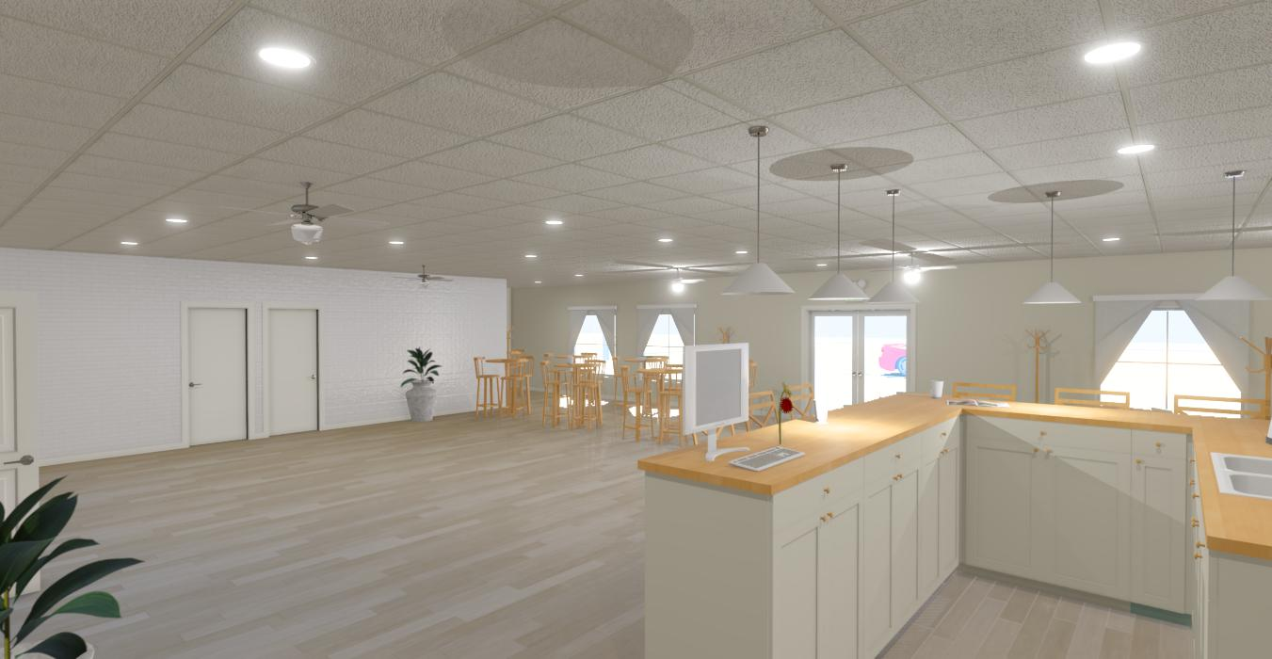

Slide 11
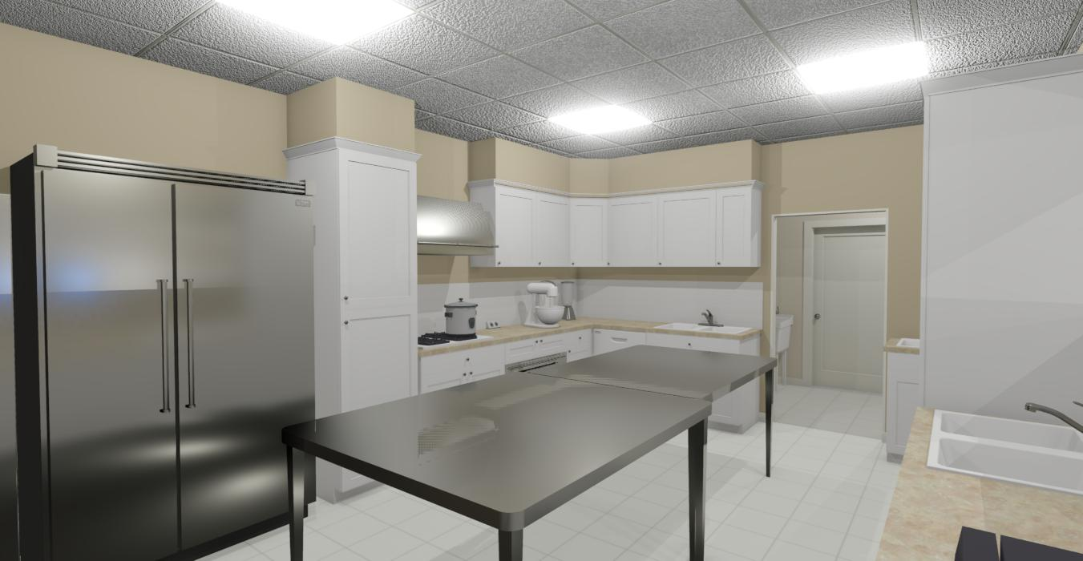

Slide 12
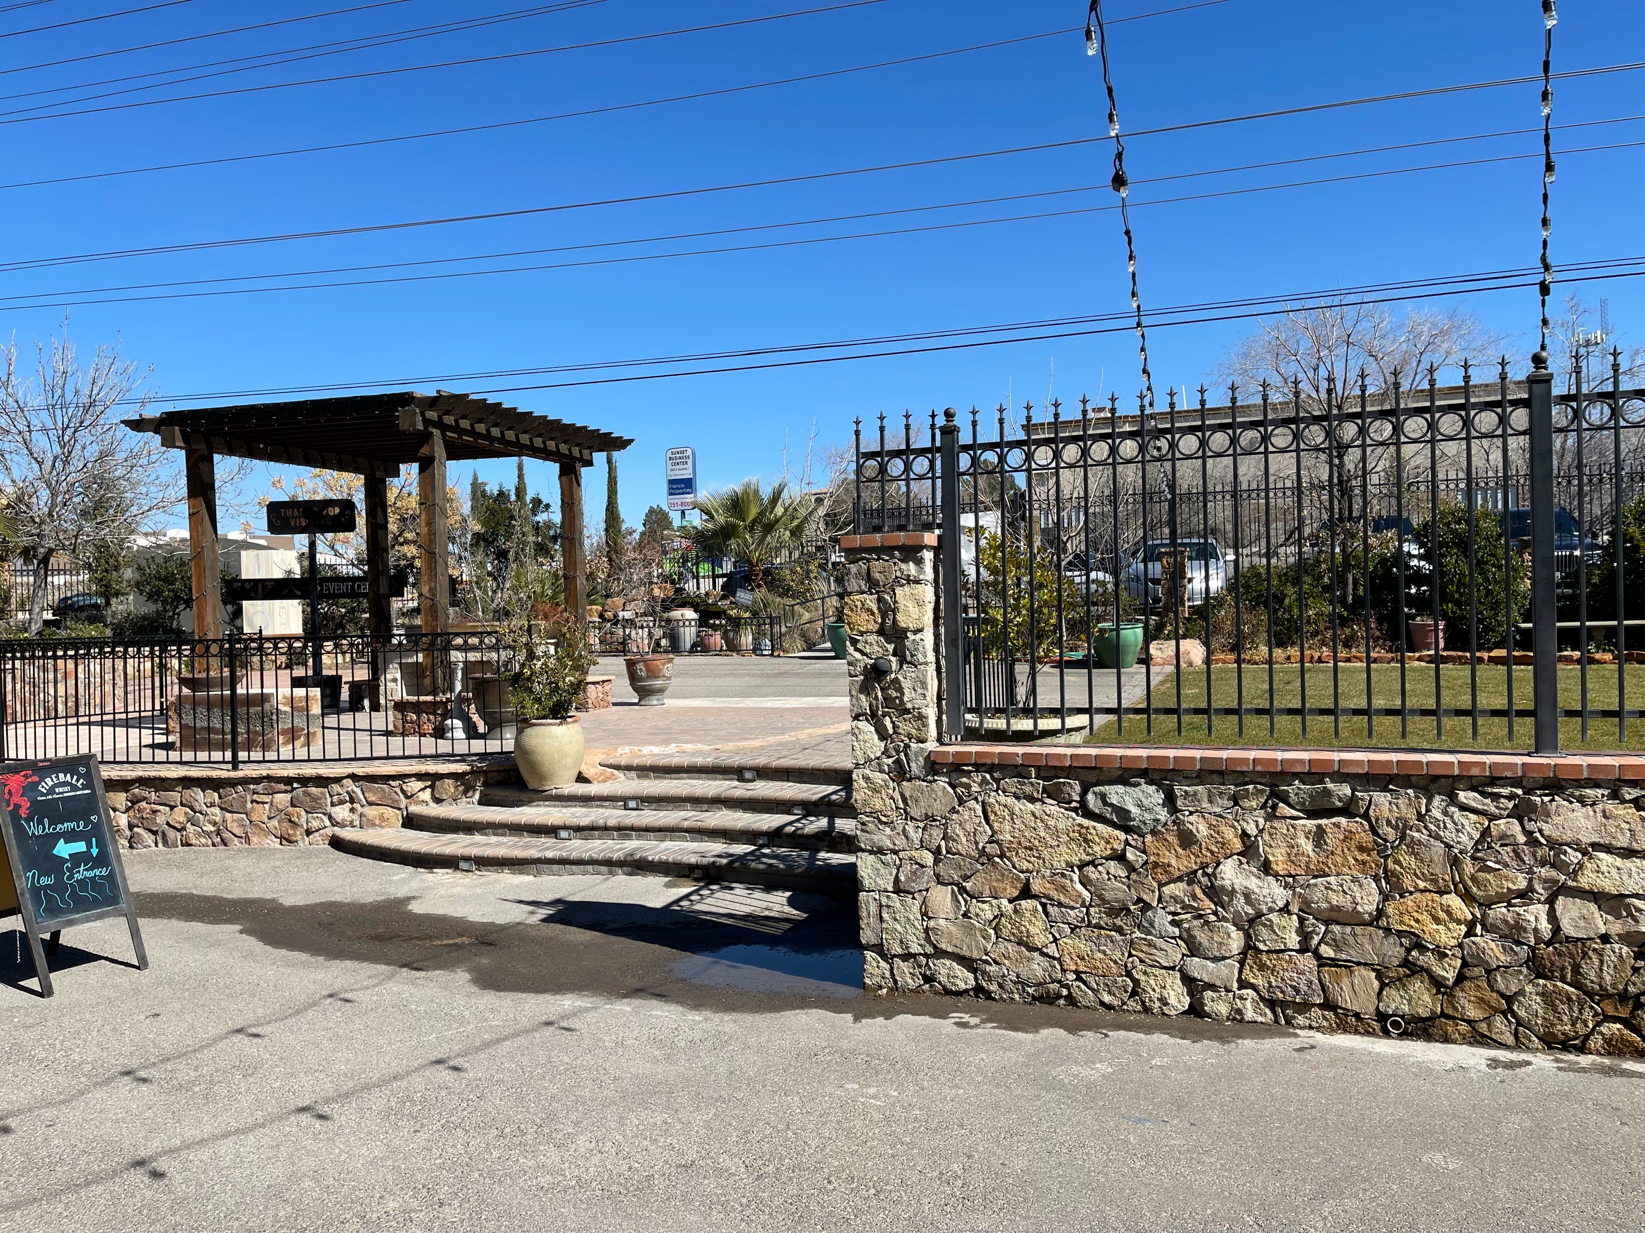

Slide 13
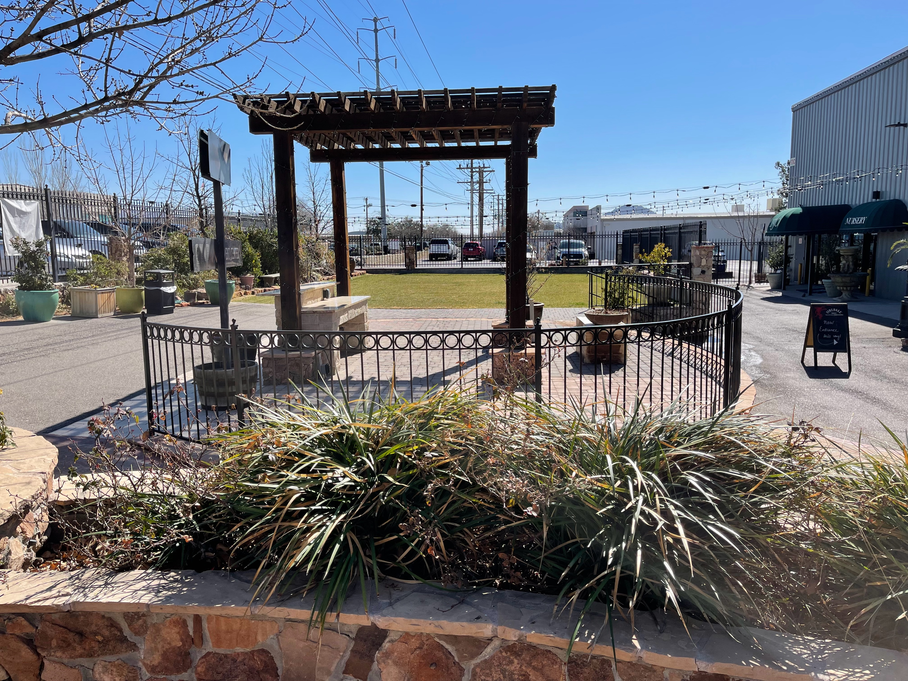

Slide 14
Four Phases
Remodel Inside of Gin
Outside of Gin
Addition to Gin
Landscaping

Slide 15
Finances
Building Fund: $167.6K
Savings: $150K
General Operations: $130-150K

Slide 17
2 25 TON AC Units - $94K

Slide 18
Finances
Building Fund: $73.6K
Savings: $150K
General Operations: $130-150K

Slide 19
Four Phases
Remodel Inside of Gin
Outside of Gin
Addition to Gin
Landscaping

Slide 20
Calvary Chapel Sun City
Gin Remodel Project
11/12/2023

